Slide 1

Print Ease: A Campus Quick-Commerce Platform for On-Demand Academic Printing
Done By:
Saranraj M (192511182)
Manoj M (192511060)
Denzil moses S (192511036)
Guided By:
Dr. A. Mohan
Dr. E. Meganadhan
1

Slide 2
Problem Statement
Saveetha University students often get access to hall tickets and certain academic documents very close to the examination or submission time.
Students must obtain printed copies immediately, but the available printing support inside the campus is limited.
Hostel students face additional difficulty because urgent printing outside the campus may not always be feasible.
The dependency on a single campus print shop creates congestion, long waiting time, and service delays during exam periods.
Last-minute printing of hall tickets, assignments, and records becomes stressful due to queue overload and lack of a structured ordering system.
3/20/2025
2

Slide 3
Introduction
Printing academic documents is a common and essential need for college students.
Students often face difficulty printing hall tickets, assignments, and records on time, especially during urgent situations.
Limited campus printing facilities and long queues increase the problem.
PrintEase is proposed to connect students with nearby print shops for quick and reliable printing services.
The system supports document upload, order placement, and print delivery or pickup.
3
Notes:
3

Slide 4
Proposed System
Print Ease is a web-based campus printing platform developed to handle urgent academic printing requirements efficiently.
The system enables students to upload documents such as hall tickets, assignments, records, and lab-related files through an online interface.
Students can select a nearby print shop, specify printing details, and place the order digitally instead of visiting the shop first.
The print shop owner receives the request, views the document details, prints the file, and updates the order status through the system.
Overall, the proposed system provides a faster, more organized, and student-friendly solution for academic printing inside and around the campus environment.
3/20/2025
4
Notes:
4

Slide 5
Existing System
Students currently download hall tickets, assignments, records, and other academic documents manually from the college portal or their devices.
To obtain printed copies, they must visit a print shop directly and wait for the printing process.
There is no proper system for online document submission, advance order placement, or print status tracking.
The existing process is fully manual and becomes inefficient during last-minute academic printing needs.
*
5

Slide 6
Objectives
To develop a web-based platform for on-demand academic printing.
To help students print urgent documents such as hall tickets, assignments, and records without unnecessary delay.
To connect students with nearby print shops through a digital ordering system.
To support efficient management of students, print shops, and printing orders through a centralized system.
6

Slide 7
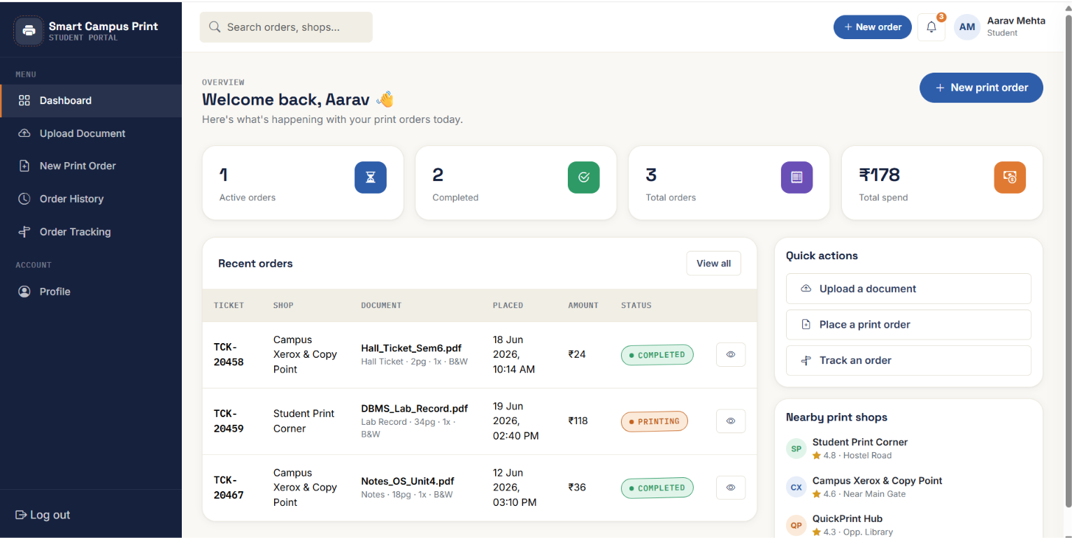
Module 1
Student Module
Register / Login
Upload Document
Place Order
Track Order
Order History
Profile

Slide 8
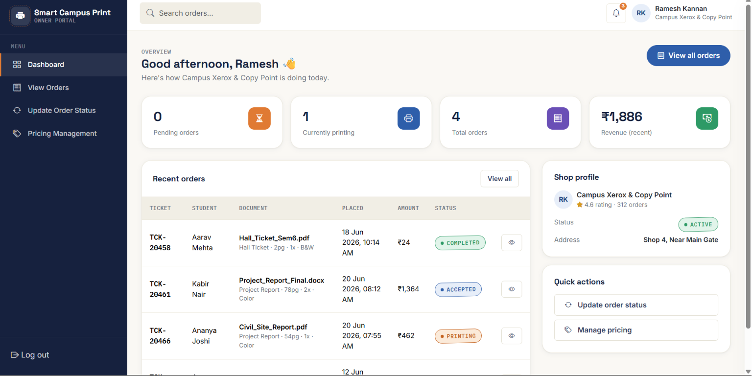
Module 2
Print Shop Owner Module
Login
View Orders
Order Details
Update Status
Pricing
*
8

Slide 9
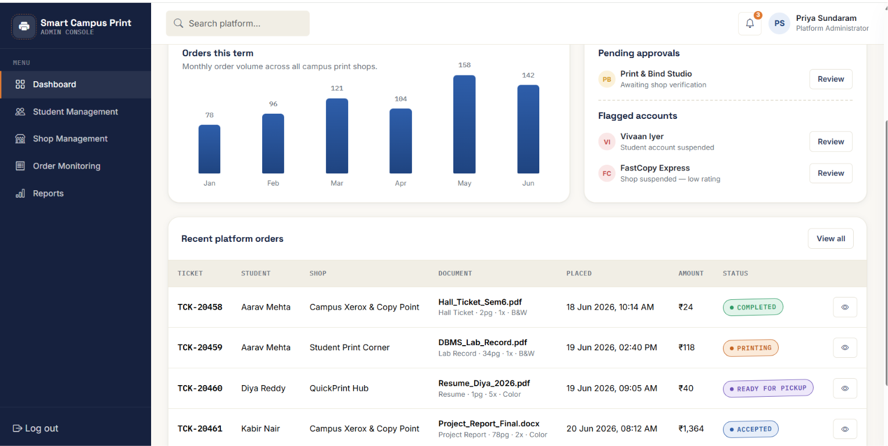
Module 3
ADMIN MODULE:
Admin
Login
Dashboard Access
Student Records Management
User Details Management
Print Shop Management
Shop Information Management
Print Order Monitoring
Order Management
Order Status Control
*
9

Slide 10
Technology Stack
Frontend: HTML, CSS, JavaScript
Backend: Spring Boot (Java)
Database: MySQL
*
10

Slide 11

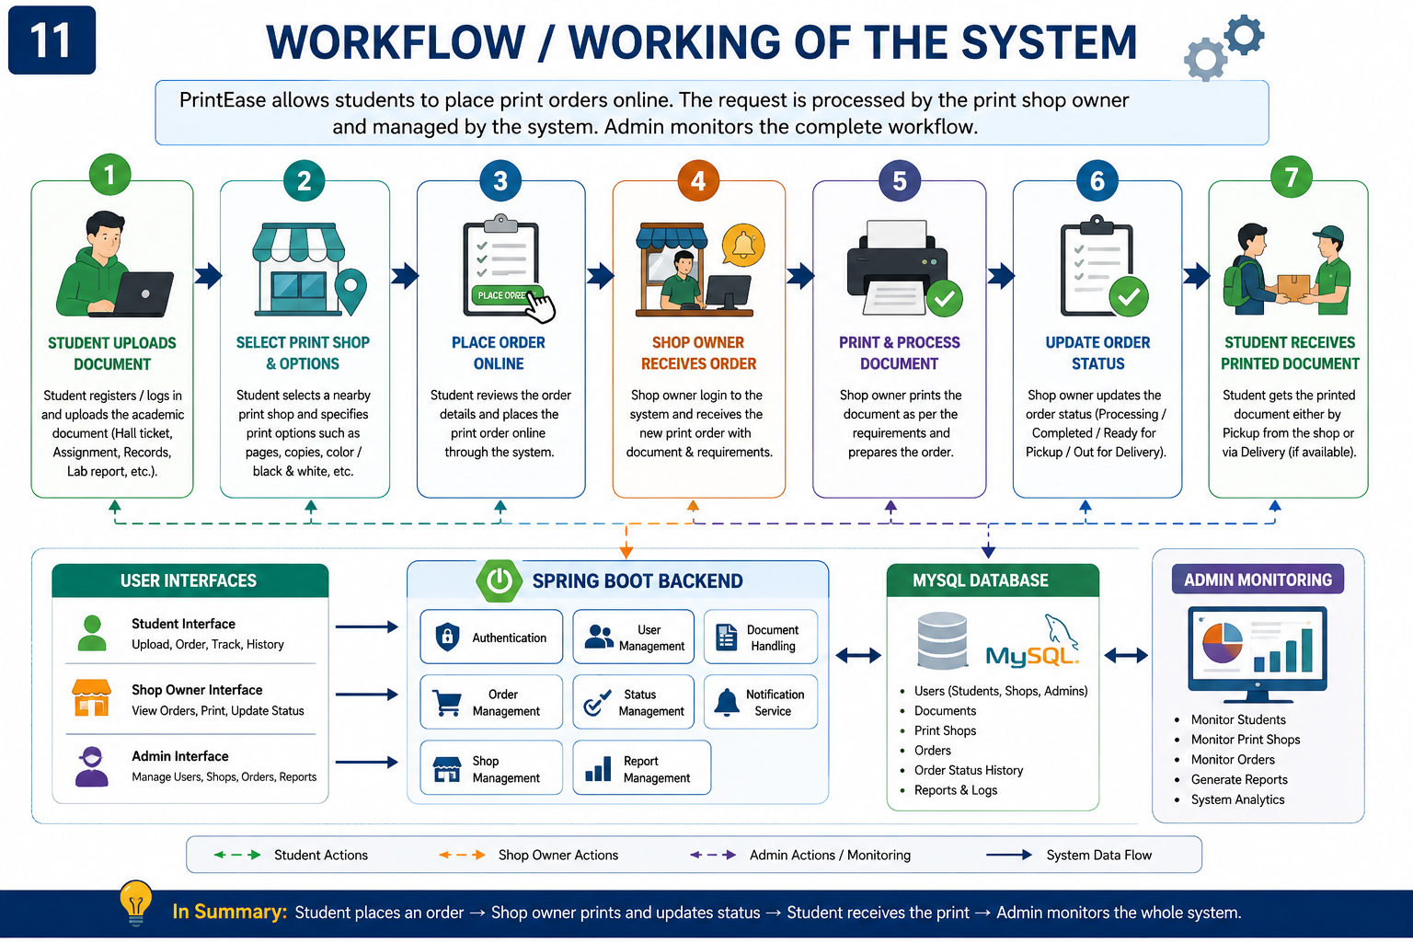
Workflow
11

Slide 12
Advantages
Reduces the difficulty of last-minute academic printing for students.
Helps students obtain urgent documents such as hall tickets, assignments, and records in a faster and more organized way.
Saves time by allowing students to upload documents and place print orders online instead of visiting the shop first.
Benefits hostel students by providing a more convenient way to access nearby printing services.
Supports both pickup and delivery, making the system more flexible for urgent academic needs.

Slide 13
Future Enhancements
Add online payment integration for digital transaction support.
Introduce live order and delivery tracking for better user convenience.
Integrate with more nearby print shops for wider service availability.
Provide priority printing support for urgent hall tickets and exam documents.
Expand the platform to support multiple campuses and institutions.

Slide 14
Conclusion
PrintEase is a web-based solution developed to support urgent academic printing for students.
It helps address problems such as late hall ticket access, queue congestion, and limited printing availability within the campus environment.
Thus, the proposed system improves the efficiency and accessibility of academic printing services in Saveetha University.

Slide 15
References
[1] H. M. Deitel and P. J. Deitel, Java: How to Program, 12th ed. Pearson Education, 2021.
[2] K. Sierra and B. Bates, Head First Java, 3rd ed. O'Reilly Media, 2022.
[3] E. Balagurusamy, Programming with Java: A Primer, 6th ed. McGraw Hill Education, 2019.
[4] Oracle Corporation, The Java™ Platform, Standard Edition Documentation. Available: https://docs.oracle.com/javase/
[5] Oracle Corporation, Java AWT (Abstract Window Toolkit) Documentation. Available: https://docs.oracle.com/javase/8/docs/api/java/awt/package-summary.html

Slide 16
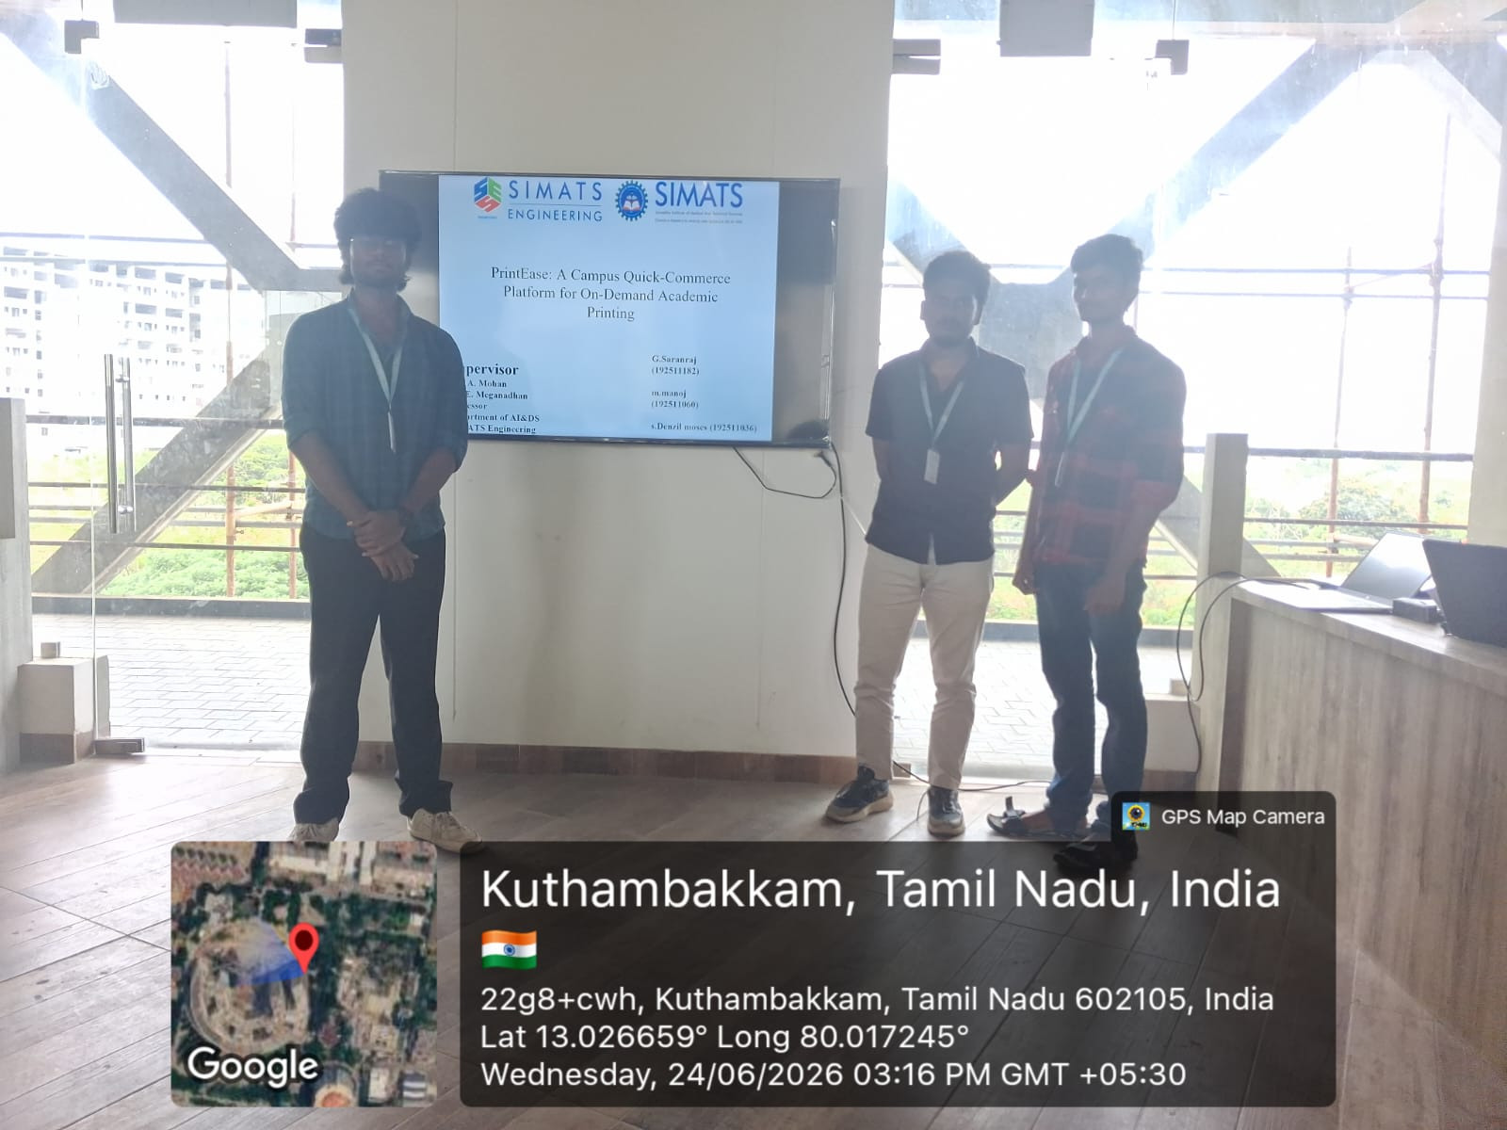

Slide 17
THANK YOU
17

